Slide 1
Revelation Chapter 12
The War in Heaven

Slide 2
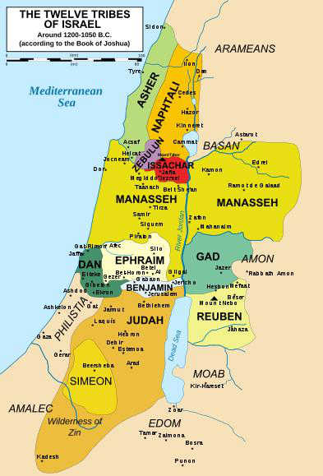
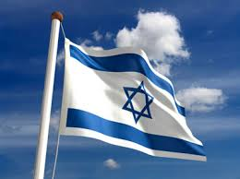
“And there appeared a great wonder in heaven; a woman clothed with the sun, and the moon under her feet, and upon her head a crown of twelve stars: And she being with child cried, travailing in birth, and pained to be delivered.” (Revelation 12:1-2)

Slide 3
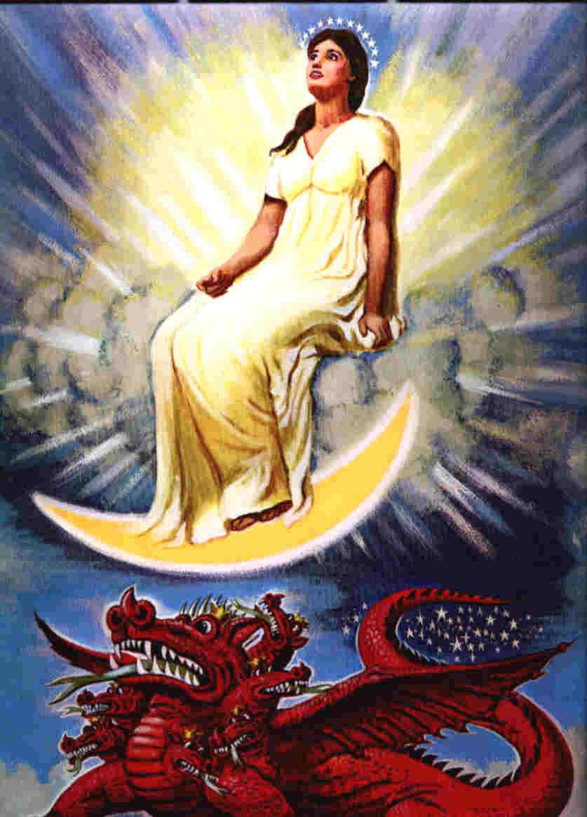

Slide 4
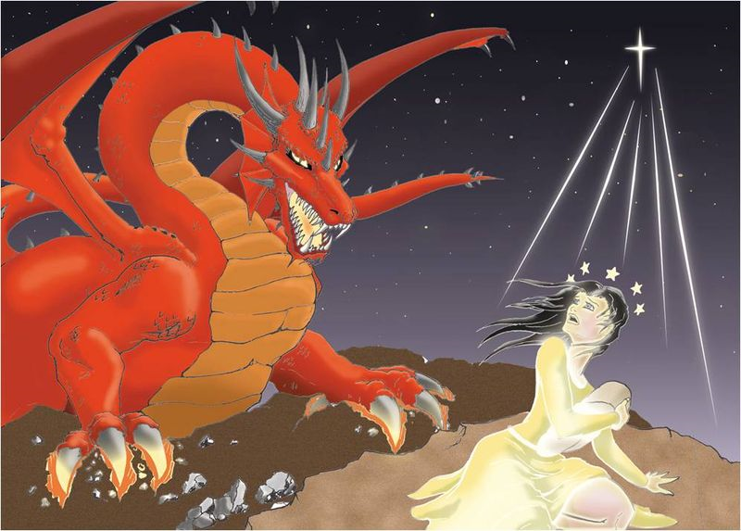
“And there appeared another wonder in heaven; and behold a great red dragon, having seven heads and ten horns, and seven crowns upon his heads. And his tail drew the third part of the stars of heaven, and did cast them to the earth: and the dragon stood before the woman which was ready to be delivered, for to devour her child as soon as it was born.” (Revelation 12:3-4)

Slide 5
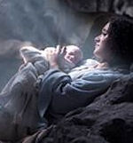
And she brought forth a man child, who was to rule all nations with a rod of iron: and her child was caught up unto God, and to his throne. (Revelation 12:5)

Slide 6
“And the woman fled into the wilderness, where she hath a place prepared of God, that they should feed her there a thousand two hundred and threescore days.” (Revelation 12:6)

Slide 7
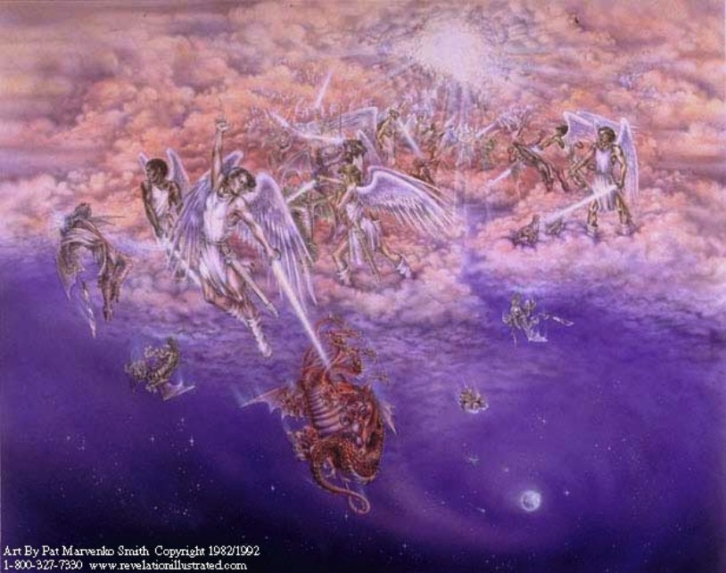
“And there was war in heaven: Michael and his angels fought against the dragon; and the dragon fought and his angels, And prevailed not; neither was their place found any more in heaven.” (Revelation 12:7-8)

Slide 8
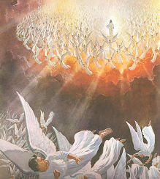
“And the great dragon was cast out, that old serpent, called the Devil, and Satan, which deceiveth the whole world: he was cast out into the earth, and his angels were cast out with him.” (Revelation 12:9)

Slide 9
“And I heard a loud voice saying in heaven, Now is come salvation, and strength, and the kingdom of our God, and the power of his Christ: for the accuser of our brethren is cast down, which accused them before our God day and night. And they overcame him by the blood of the Lamb, and by the word of their testimony; and they loved not their lives unto the death.” (Revelation 12:10-11)

Slide 10
“And they overcame him by the blood of the Lamb, and by the word of their testimony; and they loved not their lives unto the death.” (Revelation 12:11)

Slide 11
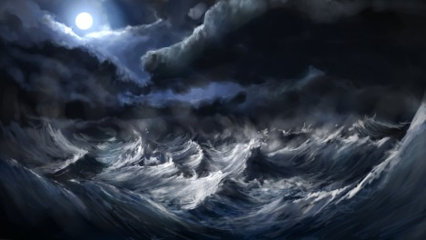
“Therefore rejoice, ye heavens, and ye that dwell in them. Woe to the inhabiters of the earth and of the sea! for the devil is come down unto you, having great wrath, because he knoweth that he hath but a short time.” (Revelation 12:12)

Slide 12
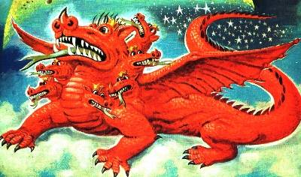
And when the dragon saw that he was cast unto the earth, he persecuted the woman which brought forth the man child.” (Revelation 12:13)

Slide 13
“And to the woman were given two wings of a great eagle, that she might fly into the wilderness, into her place, where she is nourished for a time, and times, and half a time, from the face of the serpent. “ (Revelation 12:14)

Slide 14
“And the serpent cast out of his mouth water as a flood after the woman, that he might cause her to be carried away of the flood. And the earth helped the woman, and the earth opened her mouth, and swallowed up the flood which the dragon cast out of his mouth.” (Revelation 12:15-16)

Slide 15
“And the dragon was wroth with the woman, and went to make war with the remnant of her seed, which keep the commandments of God, and have the testimony of Jesus Christ. “(Revelation 12:17)
OR
?

Slide 16
Satan’s war on Christians:
False churches in doctrinal error
Cults and False “Christian” religions
TV and radio’s false evangelists
Ecumenicalism
ACLU and Atheism, Agnosticism
Compromising churches and denominations
Evolution
Marxist atheistic government
Pagan religions such as Islam, Hinduism, etc.
….a host of other attacks.

Slide 17
“Therefore rejoice, ye heavens, and ye that dwell in them. Woe to the inhabiters of the earth and of the sea! for the devil is come down unto you, having great wrath, because he knoweth that he hath but a short time. “(Revelation 12:12)

Slide 18
“And when the dragon saw that he was cast unto the earth, he persecuted the woman which brought forth the man child. “ (Revelation 12:13)
The context puts this persecution in the middle of the seven years of Tribulation when Satan is cast to the earth.

Slide 19
Satan is cast from heaven and possesses the Antichrist.

Slide 20
“And to the woman were given two wings of a great eagle, that she might fly into the wilderness, into her place, where she is nourished for a time, and times, and half a time, from the face of the serpent.” (Revelation 12:14)

Slide 21
God will protect and nourish Israel as sees flees the persecution of the Satan possessed Antichrist.
“When ye therefore shall see the abomination of desolation, spoken of by Daniel the prophet, stand in the holy place, (whoso readeth, let him understand:) Then let them which be in Judaea flee into the mountains:” (Matthew 24:15-16)

Slide 22
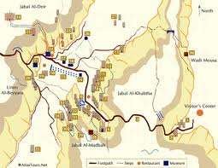
The Jews will flee to Petra, and the mountains toward the east across the River Jordan.

Slide 23
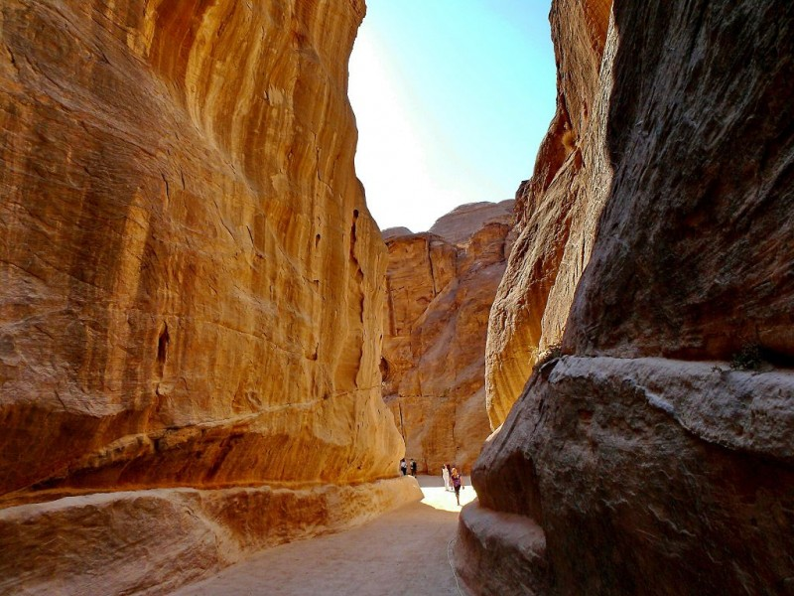

Slide 24
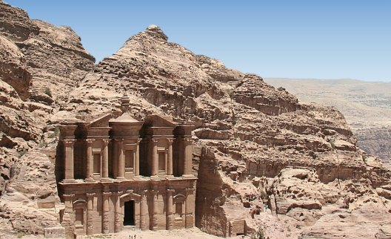
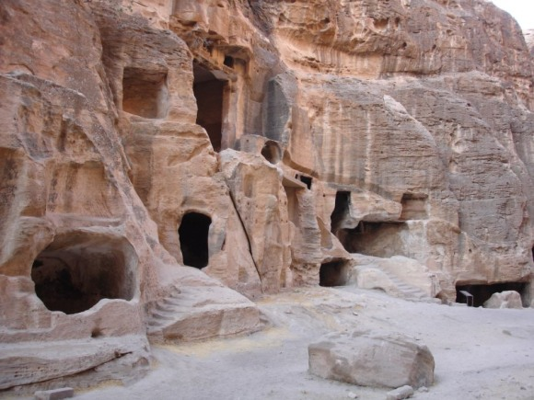
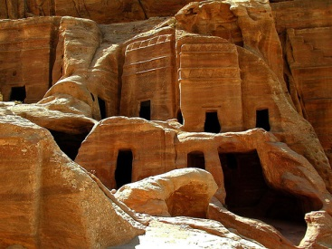
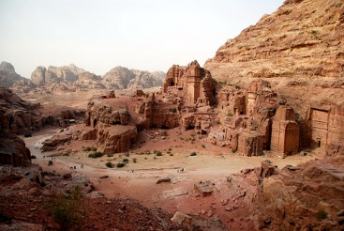

Slide 25
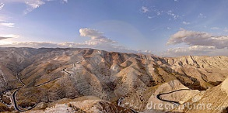
Judean desert and mountains

Slide 26
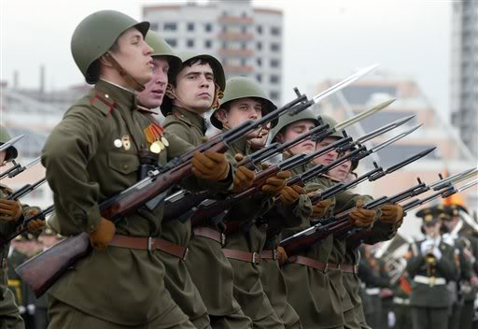
And the serpent cast out of his mouth water as a flood after the woman, that he might cause her to be carried away of the flood.” (Revelation 12:15)

Slide 27
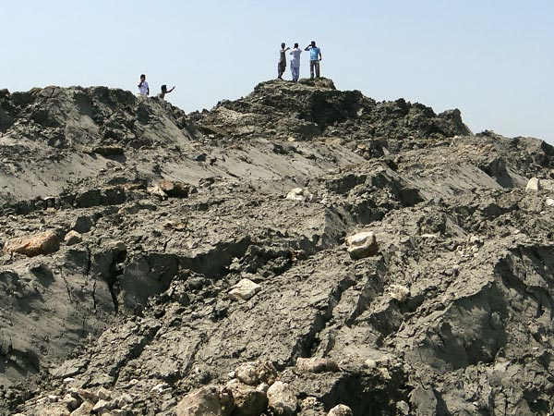
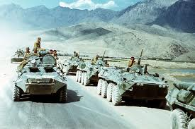
Earth swallows up the Antichrist’s Army

Slide 28
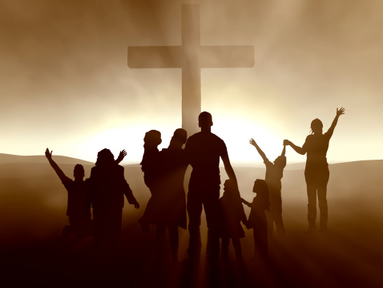
And the dragon was wroth with the woman, and went to make war with the remnant of her seed, which keep the commandments of God, and have the testimony of Jesus Christ. (Revelation 12:17)
“. . .which keep the commandments of God, and have the testimony of Jesus Christ. “

