Slide 1
PHILADELPHIA A CHURCH WITH A MISSION Revelation 3:7-13
The Church of Brotherly Love

Slide 2
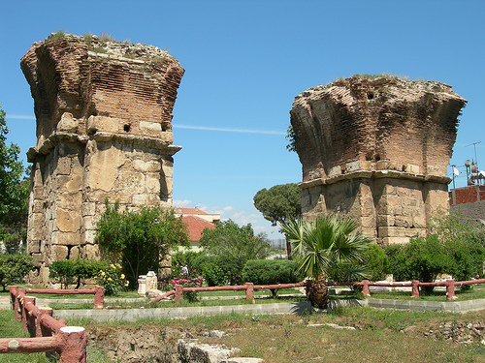
Byzantine basilica, the church of St. John (c. 600 AD).
The city of brotherly love. Founded by two Pergamon Kingdom's brothers. Known today as Alasehir. A biblical city known as the faithful city in the Book of Revelation.

Slide 3
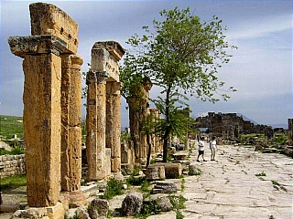
The city of Philadelphia in Asia Minor was an important and wealthy trade center in ancient Lydia that retained its importance until late Byzantine times.
Gate of Domitian, the Arcadian Way, the 2nd century AD Theatre, the Nymphaion, the Temple of Apollo, the Plutonium and the Necropolis.

Slide 4
“And to the angel of the church in Philadelphia write; These things saith he that is holy, he that is true, he that hath the key of David, he that openeth, and no man shutteth; and shutteth, and no man openeth;“ (Revelation 3:7)

Slide 5
“I know thy works: behold, I have set before thee an open door, and no man can shut it: for thou hast a little strength, and hast kept my word, and hast not denied my name. (Revelation 3:8)

Slide 6
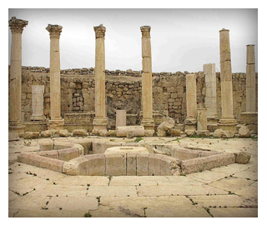
“Behold, I will make them of the synagogue of Satan, which say they are Jews, and are not, but do lie; behold, I will make them to come and worship before thy feet, and to know that I have loved thee.” (Revelation 3:9)

Slide 7
“Because thou hast kept the word of my patience, I also will keep thee from the hour of temptation, which shall come upon all the world, to try them that dwell upon the earth.” (Revelation 3:10)

Slide 8
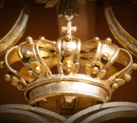
“Behold, I come quickly: hold that fast which thou hast, that no man take thy crown. “(Revelation 3:11)

Slide 9
”Him that overcometh will I make a pillar in the temple of my God, and he shall go no more out: and I will write upon him the name of my God, and the name of the city of my God, which is new Jerusalem, which cometh down out of heaven from my God: and I will write upon him my new name.” (Revelation 3:12)

Slide 10
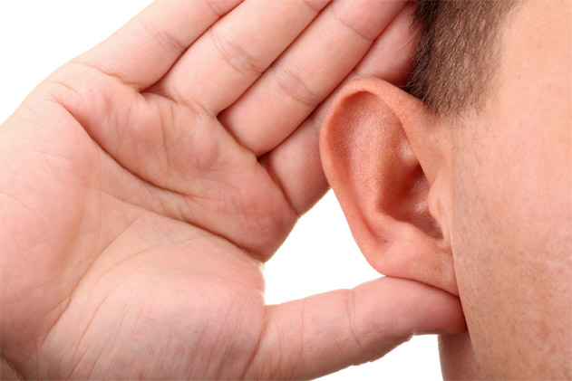
“He that hath an ear, let him hear what the Spirit saith unto the churches.” (Revelation 3:13)

