Slide 1
Revelation Chapter 13
The Beast and the False Prophet

Slide 2
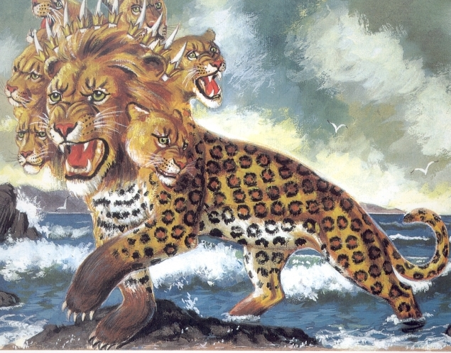
“And I stood upon the sand of the sea, and saw a beast rise up out of the sea, having seven heads and ten horns, and upon his horns ten crowns, and upon his heads the name of blasphemy. And the beast which I saw was like unto a leopard, and his feet were as the feet of a bear, and his mouth as the mouth of a lion: and the dragon gave him his power, and his seat, and great authority.” (Revelation 13:1-2)

Slide 3
Revelation 13:1-2 parallels Daniel 7:2-3
“Daniel spake and said, I saw in my vision by night, and, behold, the four winds of the heaven strove upon the great sea. And four great beasts came up from the sea, diverse one from another.” (Daniel 7:2-3)
In Nebuchadnezzar’s dream of Daniel 2, he saw a beast heading a head of gold, in which Daniel identified as King Nebuchadnezzar and the Babylonian Empire (Daniel 2:38). The beast is further described as having a breast and arms of silver, belly and thighs of brass, legs of iron, and feet of iron and clay mixed.

Slide 4
John says, "I stood." Some translations read, “he stood" or the "dragon stood." The difference in the reading comes from the dropping one Greek letter from the verb "stood."
With the letter added it means the John stood upon the sand and with the letter dropped it would mean the beast stood on the sand.
If it is the dragon standing on the sand of the sea in verse one, then this contradicts the next sentence that says the beast is rising out of the sea. The King James Bible translation is correct
John who is seen standing on the sea shore (sand) and who sees the dragon arise from its midst. The error of changing the text to read “he” or “the dragon” stood is but another of many erroneous translations of the modern the English Bibles which follow the corrupt Westcott-Hott Greek translation called the Minority or Eastern Text.

Slide 5
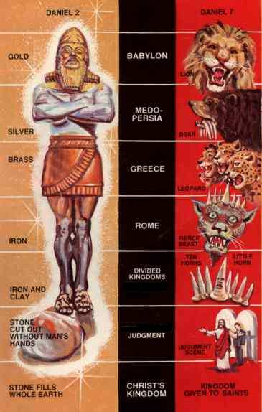
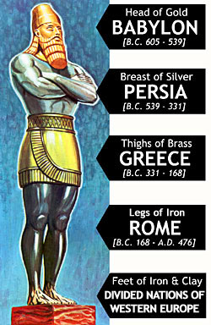

Slide 6
Daniel 7:8 identifies the beast with this description as the Revived Roman Empire and as another little horn meaning another nation. Thus it is the Antichrist who arises from the sea, probably meaning the sea or mass of humanity.

Slide 7
“Thou, O king, sawest, and behold a great image. This great image, whose brightness was excellent, stood before thee; and the form thereof was terrible. This image's head was of fine gold, his breast and his arms of silver, his belly and his thighs of brass, His legs of iron, his feet part of iron and part of clay. Thou sawest till that a stone was cut out without hands, which smote the image upon his feet that were of iron and clay, and brake them to pieces.” (Daniel 2:31-34)

Slide 8
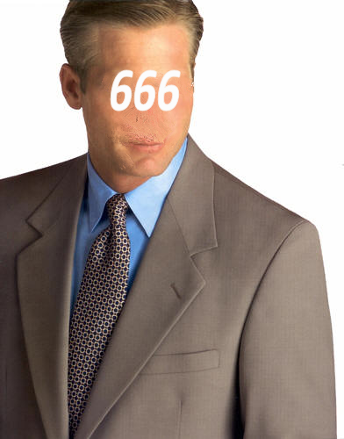
“And the beast which I saw was like unto a leopard, and his feet were as the feet of a bear, and his mouth as the mouth of a lion: and the dragon gave him his power, and his seat, and great authority. “ (Revelation 13:2)
Antichrist possessed by Satan

Slide 9
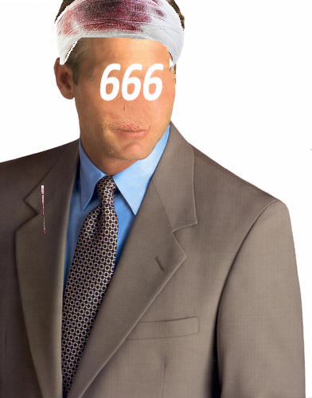
“And I saw one of his heads as it were wounded to death; and his deadly wound was healed: and all the world wondered after the beast. And they worshipped the dragon which gave power unto the beast: and they worshipped the beast, saying, Who is like unto the beast? who is able to make war with him? “ (Revelation 13:3-4)

Slide 10
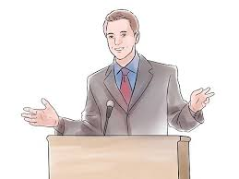
And there was given unto him a mouth speaking great things and blasphemies; and power was given unto him to continue forty and two months. (Revelation 13:5)
The Antichrist will increase in power for 3 ½ years

Slide 11
Blasphemies against God
“And he opened his mouth in blasphemy against God, to blaspheme his name, and his tabernacle, and them that dwell in heaven. “ (Revelation 13:6)

Slide 12
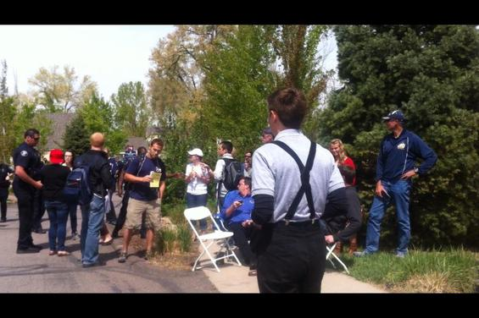
And it was given unto him to make war with the saints, and to overcome them: and power was given him over all kindreds, and tongues, and nations. (Revelation 13:7)

Slide 13
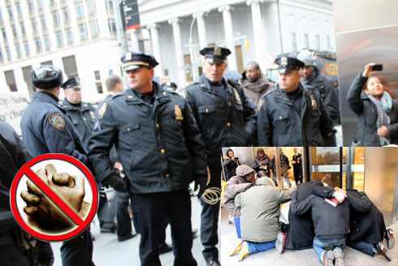
New York Police arrest men reading Bibles on side walk and praying.

Slide 14
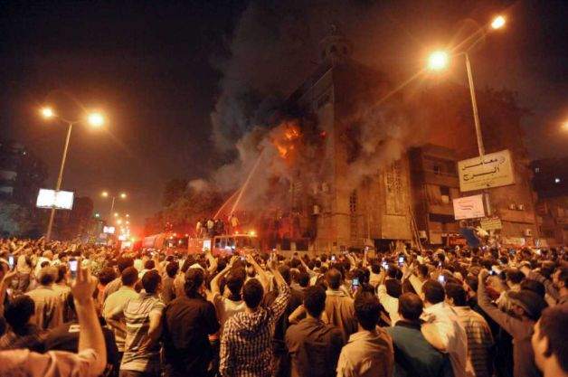
Demonstrators burn church.
“And all that dwell upon the earth shall worship him, whose names are not written in the book of life of the Lamb slain from the foundation of the world.” (Revelation 13:8)

Slide 15
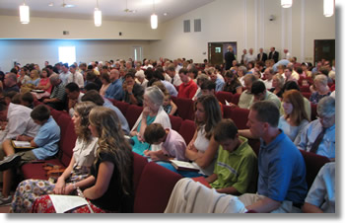
If any man have an ear, let him hear. He that leadeth into captivity shall go into captivity: he that killeth with the sword must be killed with the sword. Here is the patience and the faith of the saints. (Revelation 13:9-10)

Slide 16
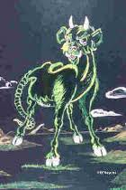
“And I beheld another beast coming up out of the earth; and he had two horns like a lamb, and he spake as a dragon. “ (Revelation 13:11)

Slide 17
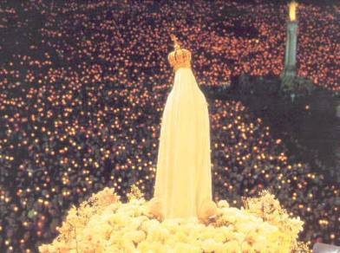
“And he exerciseth all the power of the first beast before him, and causeth the earth and them which dwell therein to worship the first beast, whose deadly wound was healed. “ (Revelation 13:12)

Slide 18
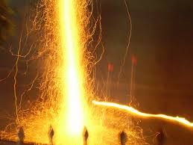
And he doeth great wonders, so that he maketh fire come down from heaven on the earth in the sight of men, (Revelation 13:13)
“And he doeth great wonders, so that he maketh fire come down from heaven on the earth in the sight of men, “(Revelation 13:13)

Slide 19
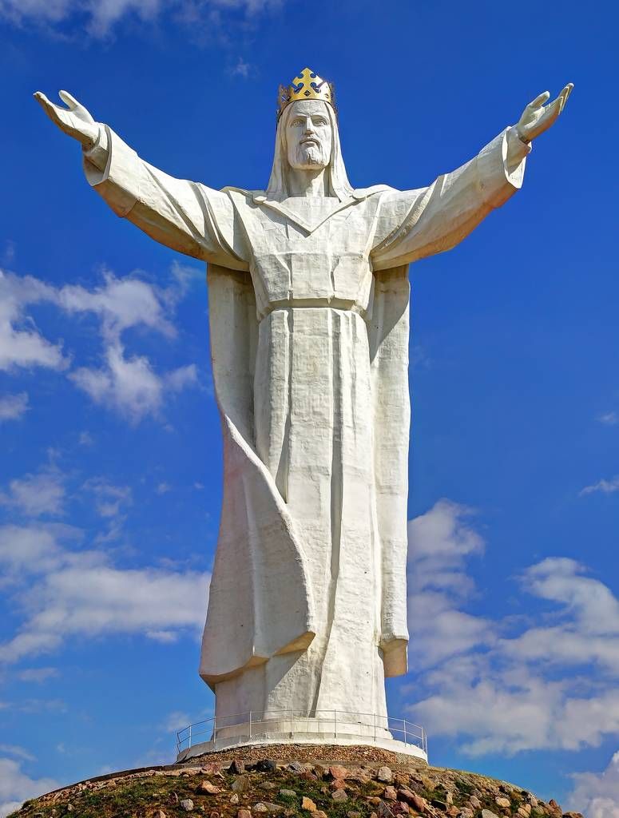
“And deceiveth them that dwell on the earth by the means of those miracles which he had power to do in the sight of the beast; saying to them that dwell on the earth, that they should make an image to the beast, which had the wound by a sword, and did live. “ (Revelation 13:14)

Slide 20
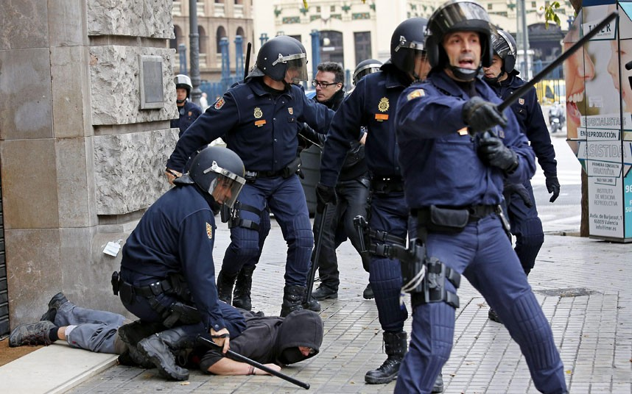
“And he had power to give life unto the image of the beast, that the image of the beast should both speak, and cause that as many as would not worship the image of the beast should be killed. “ (Revelation 13:15)

Slide 21
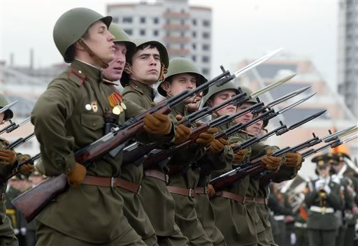
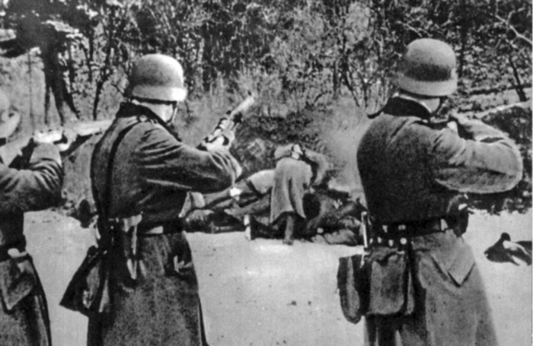
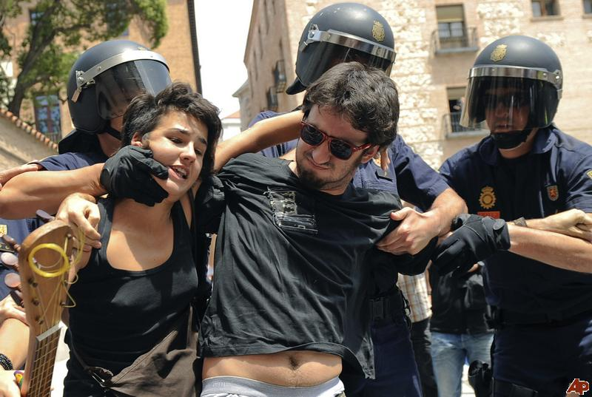
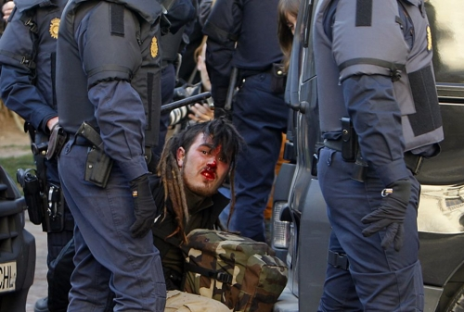

Slide 23
“And he causeth all, both small and great, rich and poor, free and bond, to receive a mark in their right hand, or in their foreheads: And that no man might buy or sell, save he that had the mark, or the name of the beast, or the number of his name.” (Revelation 13:16-17)

Slide 24
666
“Here is wisdom. Let him that hath understanding count the number of the beast: for it is the number of a man; and his number is Six hundred threescore and six.” (Revelation 13:18)

