Slide 1
Revelation Chapter 17
The Judgment of Religious Babylon

Slide 2
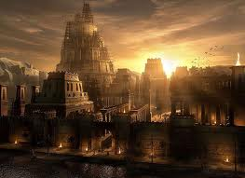
“And there came one of the seven angels which had the seven vials, and talked with me, saying unto me, Come hither; I will shew unto thee the judgment of the great whore that sitteth upon many waters: With whom the kings of the earth have committed fornication, and the inhabitants of the earth have been made drunk with the wine of her fornication.” (Revelation 17:1-2)

Slide 3
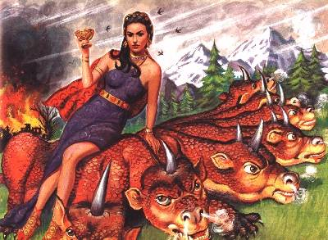
“So he carried me away in the spirit into the wilderness: and I saw a woman sit upon a scarlet coloured beast, full of names of blasphemy, having seven heads and ten horns.” (Revelation 17:3)

Slide 4
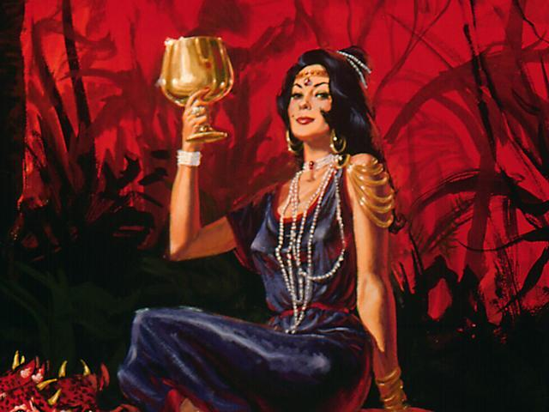
“And the woman was arrayed in purple and scarlet colour, and decked with gold and precious stones and pearls, having a golden cup in her hand full of abominations and filthiness of her fornication: “ (Revelation 17:4)

Slide 6
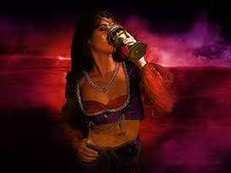
“And I saw the woman drunken with the blood of the saints, and with the blood of the martyrs of Jesus: and when I saw her, I wondered with great admiration. “ (Revelation 17:6)

Slide 7
“And the angel said unto me, Wherefore didst thou marvel? I will tell thee the mystery of the woman, and of the beast that carrieth her, which hath the seven heads and ten horns.
The beast that thou sawest was, and is not; and shall ascend out of the bottomless pit, and go into perdition: and they that dwell on the earth shall wonder, whose names were not written in the book of life from the foundation of the world, when they behold the beast that was, and is not, and yet is.” (Revelation 17:7-8)

Slide 8
“And here is the mind which hath wisdom.
- The seven heads are seven mountains, on which the woman sitteth. - And there are seven kings:
- five are fallen,
- and one is,
- and the other is not yet come;
- and when he cometh, he must continue a short space.” (Revelation 17:9-10)

Slide 9
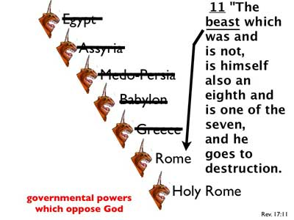
“And the beast that was, and is not, even he is the eighth, and is of the seven, and goeth into perdition. “ (Revelation 17:11)

Slide 10
“And the ten horns which thou sawest are ten kings, which have received no kingdom as yet; but receive power as kings one hour with the beast. These have one mind, and shall give their power and strength unto the beast. “ (Revelation 17:12-13)

